Slide 1



MARATHON ASSET MANAGEMENT
CORNELL CFEM CAPSTONE 2026
Marathon Project Meeting
Revisiting Data Cleaning Incorporating LLM – 2
SPONSOR: Jason Foster
ADVISOR: Sasha Stoikov
TEAM: Alex Lee, Max Yap, Minxi Lin, Yung Lee, Olivia Mei
DATE: October 8, 2026

Slide 2
Value Cleaning | Rules
MARATHON ASSET MANAGEMENT
Rules for Fair Value, Cost, and Principal
CORNELL CFEM CAPSTONE 2026
Rule | What it catches | Rows | Without it
filing_mul1000 | Whole filing tags principal in thousands; fair value matches the filer's history | 959 | $3.5B of fair value divided away
mul1000 on principal | One principal 1,000x too small; fair value matches the position's other quarters | 39 | Fair value and cost divided instead
div1000 on principal | Principal about 1,000x cost; under $1M of cost, only an exact 1,000x on an outsized position | 56 | $1.6B phantom principal; +0.25pp income in 2026Q1
div1000 on fair value / cost | Fair value or cost 1,000x or 1,000,000x the principal | 153 | Position weight inflated 1,000x
mul1000 on fair value / cost | Fair value or cost exactly 1/1,000 of the principal | 23 | $178M carried at $0.2M
filer_quarter_div1000 | Fair value, cost and principal all 1,000x too large together | 37 | 2023Q1 total $565B, not $242B
units_as_principal · equity cap | Share or unit count in the principal field, far below or far above cost | 170 | Income booked on a count, not on dollars
unit_mismatch_fixed | Principal tagged in the wrong currency (yen as usd, dollars as EGP) | 30 | About $11B of phantom principal
Currency table · ISK, KRW | Unit tags the currency table did not know | 16 | $11.7B read as USD; 8 principals blank
Rescale only round gaps | A gap that is not 1,000x or 1,000,000x is kept and flagged "unresolved" | 262 | Real positions shrunk 1,000x
Rows in the final output of 502,299; first eight rules are mutually exclusive.

Slide 3
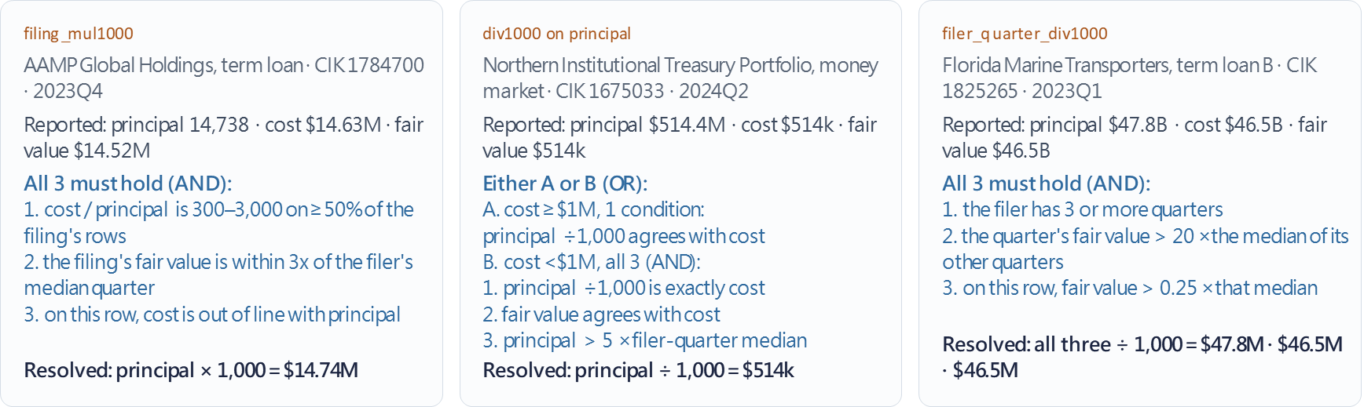
MARATHON ASSET MANAGEMENT
CORNELL CFEM CAPSTONE 2026
Examples | Handling Scale Errors in Principal
agrees with: ratio within 0.5x – 2.0x
exactly: within ±5%
out of line: more than 3x apart
about 1,000x: 300x – 3000x
Note: the same tests done with 1,000,000 besides 1,000

Slide 4
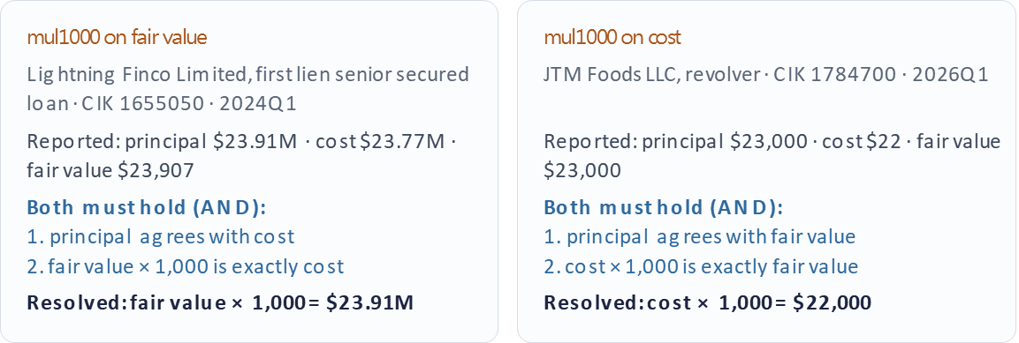
MARATHON ASSET MANAGEMENT
CORNELL CFEM CAPSTONE 2026
Examples | Handling Scale Errors in Fair Value and Cost
A small or negative fair value is otherwise untouched (uncommitted or delayed fund); not an error
agrees with: ratio within 0.5x – 2.0x
exactly: within ±5%
out of line: more than 3x apart
about 1,000x: 300x – 3000x
Note: the same tests done with 1,000,000 besides 1,000

Slide 5
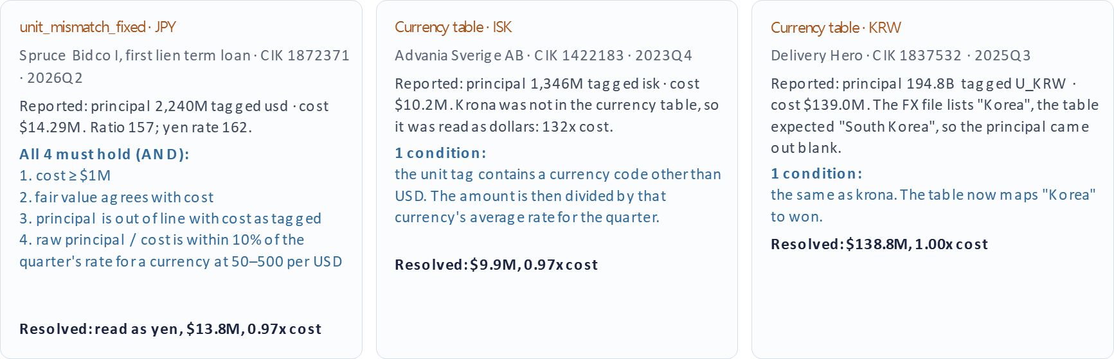
MARATHON ASSET MANAGEMENT
CORNELL CFEM CAPSTONE 2026
Examples | Handling Currency Units
agrees with: ratio within 0.5x – 2.0x
exactly: within ±5%
out of line: more than 3x apart
about 1,000x: 300x – 3000x

Slide 6
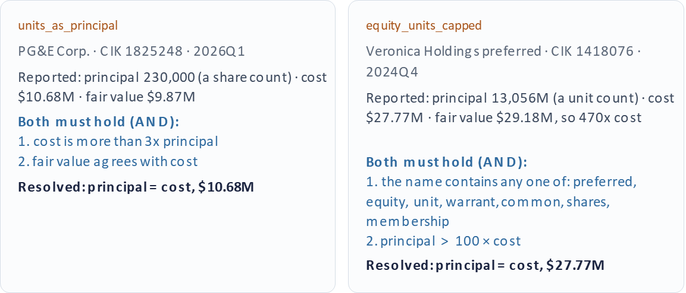
MARATHON ASSET MANAGEMENT
CORNELL CFEM CAPSTONE 2026
Examples | Handling Unit Counts
agrees with: ratio within 0.5x – 2.0x
exactly: within ±5%
out of line: more than 3x apart
about 1,000x: 300x – 3000x

Slide 7
MARATHON ASSET MANAGEMENT
CORNELL CFEM CAPSTONE 2026
Data cleaning result for FV, PAR, & COST
Negative values (kept as filed) | Rows | Min | Median | Max
Negative principal | 8 | −$134K | −$13K | −$2,449
Negative cost | 48,317 (9.62%) | −$26.47M | −$10K | −$1
Negative fair value | 37,966 (7.56%) | −$25.96M | −$14K | −$1
Unit mistagging errors (each row counted once) | As filed | Final
Principal 1,000x off | 1,054 | 0
Fair value or cost 1,000x off | 176 | 0
All three amounts 1,000x too large | 37 | 0
Share or unit count as principal | 170 | 0
Principal in the wrong currency | 30 | 0
Total | 1,467 (0.29%) | 0
Negative values are intact before and after cleaning; they mostly indicate uncommitted or delayed funds.

Slide 8
MARATHON ASSET MANAGEMENT
CORNELL CFEM CAPSTONE 2026
Missing values for FV, PAR, & COST
Fair value | Cost | Principal | Rows | % Rows | Fair value, $B
Present | Present | Present | 459,183 | 91.42% | 5,090.4
Present | Present | Missing | 19,468 | 3.88% | 272.5
Present | Missing | Present | 6,810 | 1.36% | 24.7
Present | Missing | Missing | 2,254 | 0.45% | 13.2
Missing | Present | Present | 678 | 0.13% | –
Missing | Present | Missing | 1,555 | 0.31% | –
Missing | Missing | Present | 2,606 | 0.52% | –
Missing | Missing | Missing | 9,745 | 1.94% | –
Total |  |  | 502,299 | 100.00% | 5,400.8
Fair value: 14,584 rows missing (2.90%), Cost: 21,415 rows missing (4.26%), Principal: 33,022 rows missing (6.57%)
Cleaning does not fill or drop these, so the counts are the same as filed
Fair value in $B is the sum of absolute values (aggregate cash flows involved) over all 14 quarters

Slide 9
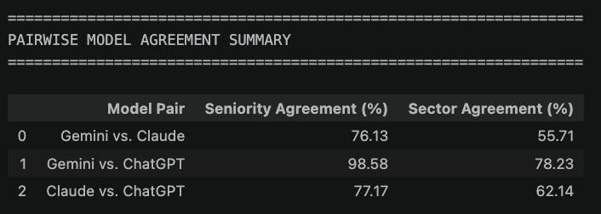
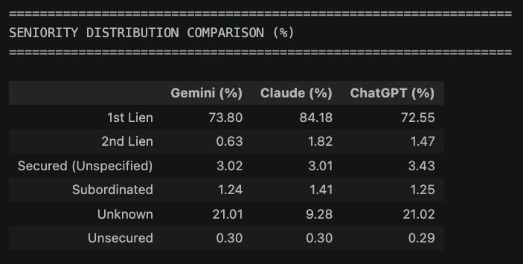
MARATHON ASSET MANAGEMENT
CORNELL CFEM CAPSTONE 2026
Sector/Loan Seniority Classification - LLM
2026 Q2 → extend to the entire dataset (future)
LLM Models: Gemini 3.1 Pro, Claude Sonnet 5.5, ChatGPT 5.6 Luna

Slide 10
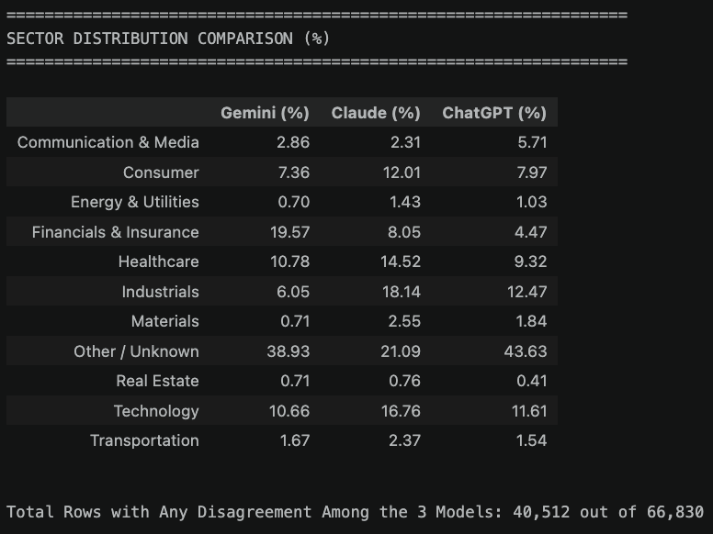
MARATHON ASSET MANAGEMENT
CORNELL CFEM CAPSTONE 2026
Sector/Loan Seniority Classification - LLM

Slide 11
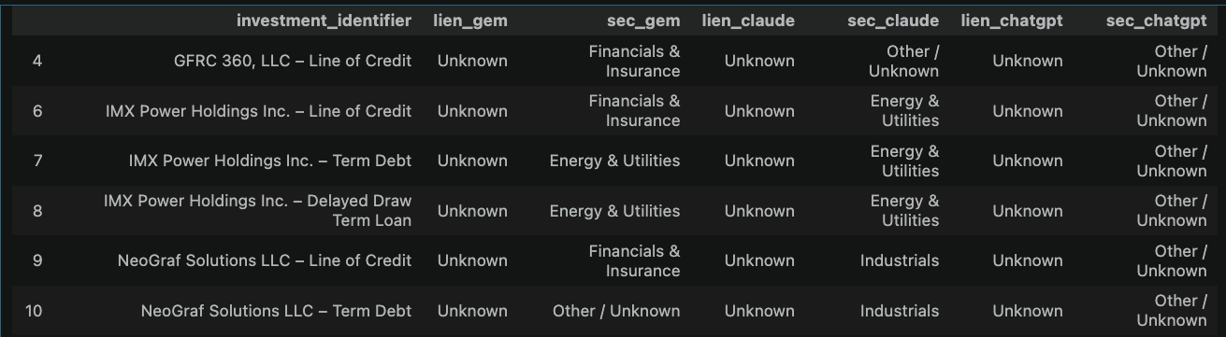
MARATHON ASSET MANAGEMENT
CORNELL CFEM CAPSTONE 2026
Sector/Loan Seniority Classification - LLM

Slide 12
MARATHON ASSET MANAGEMENT
CORNELL CFEM CAPSTONE 2026
Borrower Name - Full-Universe Evaluation
Benchmark Construction
Results
Review required: 1,486 rows, or 0.71%
Validation issue rows: 308 rows, or 0.15%
Parser failures: 3 rows, or 0.001%
Benchmark Composition | Count | Label Source
Original accepted outputs | 206,140 | Original output treated as provisional benchmark
Corrected changelog | 4,460 | Manually corrected labels
Total | 210,600
Component | Exact Matches | Total | Result
Original accepted | 196,734 | 206,140 | 95.44% preservation
Corrected changelog | 4,243 | 4,460 | 95.13% recovery
Combined | 200,977 | 210,600 | 95.43% agreement under benchmark assumption

Slide 13
MARATHON ASSET MANAGEMENT
CORNELL CFEM CAPSTONE 2026
Borrower Name - Interpreting the 9,406 Differences
The new result differs from the original accepted output in 9,406 cases, or 4.56%.
Possible error (~6,975): US Bidco, LLC v.s Cyber US Bidco, LLC
Possible additional correction (~423): United States of America SBP Holdings LP v.s SBP Holdings LP
Manual review (~2,008): Lexipol v.s Ranger Buyer, Inc.
Difference pattern | Count | Interpretation
Original name contained inside V2 output | 5,289 | V2 may have retained an extra prefix or trade name
V2 output contained inside original name | 2,675 | V2 may have removed noise or truncated the name
V2 returned null | 814 | High-priority review
Different entities selected | 623 | Semantic entity-selection conflict
Same tokens in different order | 5 | Minor normalization difference
Total | 9,406

Slide 14
MARATHON ASSET MANAGEMENT
CORNELL CFEM CAPSTONE 2026
Borrower Name - Comparison with the original pipeline
Result
Why underperformed globally
  Targeted optimization: the new pipeline was designed around the error patterns in the changelog but was applied to many names that were already clean.
  Candidate boundaries: Industry and trade-name prefixes were sometimes retained with the legal entity.
  Over-cleaning: the new pipeline sometimes returned null, truncated co-borrowers, or removed CLO and deal identifiers.
  Definition mismatch: the new pipeline prioritizes legal entities, while some original outputs use trade names.
  Limited validation: Source validation confirms that a name appears in the source, but not that the correct entity span was selected.
Pipeline | Correct under benchmark assumption | Total | Correct Percentage
Original | 206,140 | 210,600 | 97.88%
New | 200,977 | 210,600 | 95.43%

Slide 15
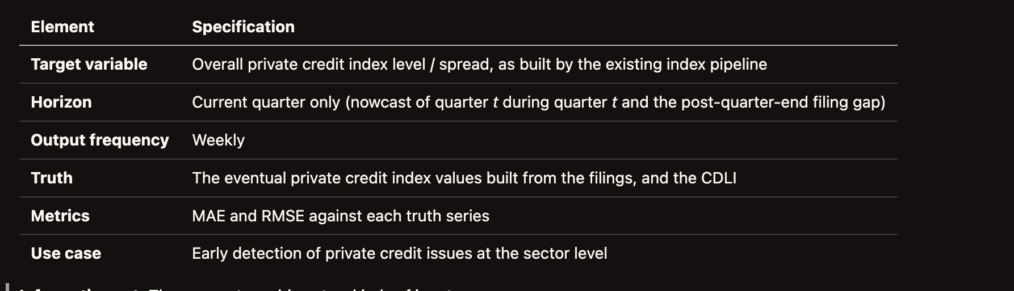
MARATHON ASSET MANAGEMENT
CORNELL CFEM CAPSTONE 2026
Nowcasting - Next Steps
Goal: Improve the use case of the index in spotting stress in private credit early
Proposal: Build a weekly nowcast of the current quarter's private credit index, update it as information arrives, and replace it with the realized value once filings are processed.
Data:
  Utilise earnings release (Form 8-K) with quarter-end NAV per share, released for some BDCs before 10-Q is filed
  Higher frequency market data (BDC prices and P/NAV discounts)

